Slide 1
CSS level 3 & beyond ..

Slide 2
History of CSS
CSS level 1 – original CSS
CSS level 2
  CSS level 2 Revision 1 (CSS2.1) – up to CSS2.1 monolithic structure
CSS level 3 – specification structured in modules
  Modules can evolve independently
  Many modules are implemented in browsers before they reach the W3C recommendation status
  Some modules are already level 4 (e.g. Colors, Selectors)
Full CSS described at http://www.w3.org/Style/CSS/specs.en.html
Summary at: http://www.css3.info
Current recommendation: https://www.w3.org/TR/css-2018/

Slide 3
CSS modules (selection)
CSS Color
CSS Namespaces
CSS Selectors
CSS Media Queries
CSS Backgrounds & Borders
CSS 2D Transformations
CSS Transitions
CSS Animations
CSS 3D Transformations
CSS Flexible Box Layout
CSS Fonts
CSS Text
CSS Grid Layout
CSS Image Values and Replaced Content

Slide 4
CSS Selectors (1)
E[attr^=“str”] - an E element whose “attr” attribute begins with “str”
E[attr$=“str”] - an E element whose “attr” attribute ends with “str”
E[attr*=“str”] - an E element whose “attr” attribute contains “str”
E[attr=“str”] – an E element whose “attr” attribute is equal to “str”
E:nth-child(n) - an E element, the n-th child of its parent
E:nth-last-child(n) - an E element, the n-th child of its parent, counting from the last one
E:nth-of-type(n) - an E element, the n-th sibling of its type
E:nth-last-of-type(n) - an E element, the n-th sibling of its type, counting from the last one
E:first-child - an E element, first child of its parent (in CSS2.1)
E:last-child - an E element, last child of its parent

Slide 5
CSS Selectors (2)
E:first-of-type - an E element, first sibling of its type
E:last-of-type - an E element, last sibling of its type
E:only-child - an E element, only child of its parent
E:only-of-type - an E element, only sibling of its type
E:empty - an E element that has no children
E:not(s₁,s₂,..) - an E element that does not match selectors s₁,s₂,..
E:is(s₁,s₂,..) - an E element that matches one of selectors s₁,s₂,..
E > F - an F element child of an E element (in CSS2.1)
E + F - an F element immediately preceded by an E element (in CSS2.1)
E ~ F - an F element preceded by an E element

Slide 6
CSS Selectors (3)
* - selects everything, every tag
E:has(> F) – an E element that has an F child
E[attr=“str" i] – an E element with an attribute “attr” equal cu “str” (case insensitive)
E[attr=“str" s] – an E element with an attribute “attr” equal cu “str” (case sensitive)
E:current, E:past, E:future - timeline selectors, select an element in a time-dimensional canvas; Ex.;
:current(p) { background : yellow } - selects and colors the paragraph of text that is currently read in a speech rendering of the document

Slide 7
Gradient images - linear
Linear gradient
background: linear-gradient([direction], color-stop1, color-stop2,…)
  direction=<angle> | [to] <side-or-corner>
  there can be several direction arguments;
  angle=0deg, 90deg, 100deg, ..
  side-or-corner=bottom, top, right, left
  color-stops can be followed by a percent or length in pixels specifying the position of the color in the gradient, along the gradient line
  color-stop=blue, red, .., rgb(rrr, ggg, bbb), rgba(rrr, ggg, bbb, aaa) where aaa=1 (no transparency) and aaa=0 (full transparency)
Linear repeating gradient
background: linear-repeating-gradient ([direction], color-stop1, color-stop2,…)
  the parameters are the same as for the simple linear gradient
Chrome uses prefix –webkit- and Firefox uses prefix –moz-

Slide 8
Gradient images - radial
Radial gradient (center/elliptical gradient defined by its center)
background: radial-gradient(<center position> <shape> <size>, color-stop1, color-stop2, …)
  <center position>=center(default) or position given with 2 points
  shape=circle or ellipse
  size=the radius(es) of gradient as <length> | <percentage> or closest-side, farthest-side, closest-corner, farthest-corner
Radial repeating gradient
background: radial-repeating-gradient(<center position> <shape> <size>, color-stop1, color-stop2, …)
Chrome uses prefix –webkit- and Firefox uses prefix –moz-

Slide 9
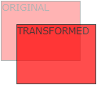
2D Transforms (1)
we can translate, scale, turn, spin and stretch elements
Chrome uses –webkit- prefix
CSS properties:
  transform : transform-function1 transform-function2 ..
  -> applies a 2D or 3D transformation to an element
  transform-origin : <percentage> | <length> | left | center | right | top | bottom -> allows the user to change the position on transformed elements (moves the point of origin of transformation)
2D transform functions - translate:
  translate(x,y) – moves the element along the X and Y axes
  translateX(x) – moves the element along the X axis
  translateY(y) – moves the element along the X axis

Slide 10
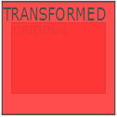

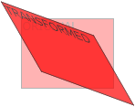
2D Transforms (2)
2D transform functions – scale, skew, rotate, general :
  scale(x,y) – changes the width to x times the original and the height to y times the original
  scaleX(x) – changes the width to x times the original
  scaleY(y) – changes the height to x times the original
  rotate(angle) – rotate element by angle;
  ex.: rotate(45deg);
  skew(x-angle,y-angle) – skew transform along the X and Y axes
  skewX(x-angle) – skew transform along the X axis
  skewY(y-angle) – skew transform along the Y axis
  matrix(n,n,n,n,n,n) – general transformation

Slide 11
3D Transforms (1)
apply 3D transforms to elements
Chrome uses –webkit- prefix
CSS properties:
  transform : transform-function1 transform-function2 ..
  transform-origin : <percentage> | <length> | left | center | right | top | bottom
  transform-style : flat | preserve-3d -> a nested child element will not preserve its 3d position (‘flat’) or it will preserve it position (‘preserve-3d’)
  perspective : none | number -> how many pixels the element is placed from the viewport
  perspective : x y -> define the view’s x- and y-axis for nested elements; x,y= left | center | right | length | percent

Slide 12
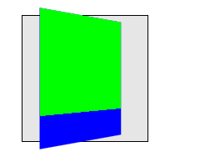
3D Transforms (2)
3D transform functions:
  translate3d(x,y,z)
  translateX(x)
  translateY(y)
  translateZ(z)
  scale3d(x,y,z)
  scaleX(x)
  scaleY(y)
  scaleZ(z)
  rotate3d(x,y,z,angle)
  rotateX(angle)
  rotateY(angle)
  rotateZ(angle)
  perspective(n)
  matrix3d(n,n,n,n,n,n,n,n,n,n,n,n,n,n,n,n) – 3D transform 4x4 matrix

Slide 13
Transitions - properties
add effects when changing from a style to another (e.g. when :hover is used), like flash or javascript
Style properties used:
  transition-property : comma separated list of property names to which transition is applied
  transition-duration : how long it take the transition to be completed (ex.: transition-duration : 2s)
  transition-delay : when transition will start (ex.: transition-delay: 1s)
  transition-timing-function : defines the speed of the transition; values: linear|ease|ease-in|ease-out|ease-in-out|cubic-bezier(n,n,n,n)
  transition : shorthand property for the above properties

Slide 14
Transitions - examples
simple example:
div {
transition-property: width;
transition-duration: 5s;
}
div:hover { width: 100px }
multiple properties example:
div {
width: 20px;
transition: width 3s, transform 3s;
}
div:hover {
width: 100px;
transform: rotate(90deg);
}

Slide 15
Animations - properties
@keyframes : defines the frames of the animation
animation-name : defines the animation name, used in @keyframes
animation-duration : duration of the animation
animation-timing-function : defines the speed of the transition; values: linear|ease|ease-in|ease-out|ease-in-out|cubic-bezier(n,n,n,n)
animation-delay : startup delay (in seconds)
animation-iteration-count : how many times the animation is played
animation-direction : the direction in which animation is played (normal | reverse | alternate | alternate-reverse)
animation-play-state : running or pausing the animation
animation – shorthand property

Slide 16
Animations - @keyframes
@keyframes name-of-animation {
keyframe-selector {
property: value;
…
property: value;
}
…
keyframe-selector {
property: value;
…
property: value;
}
}
keyframe-selector is either ‘from’ (=0%), ‘to’ (=100%) or a percent of animation
Duration from 0% to 100%.
property is a CSS property.

Slide 17
Animations - example
@keyframes move {
0% { left: 100px; }
40% { left: 130px; }
100% { left: 150px; }
}
div {
animation: move 5s;
}

Slide 18
Multiple columns
Firefox uses prefix –moz- and Chrome uses –webkit-
Useful properties:
  column-count : no. of columns an element is divided
  column-fill : how to fill columns (balance | auto)
  column-gap : space between columns (dimension)
  column-rule-color : color of rule between columns (same as border-color)
  column-rule-style : style of rule between columns (same as border-style)
  column-rule-width : width of rule between columns (same as border-width)
  column-span : span of a column
  column-width : width of columns
  columns : shorthand for column-width and column-count

Slide 19
Multiple columns - example
div {
column-count : 3;
column-rule-color : black;
column-rule-style : dotted;
column-rule-width : 1px;
}
div {
columns: 40px 2;
}

Slide 20
Borders
border-radius : (<length> | <percent>) {1,4} / (<length> | <percent>) {1,4}
create rounded corners; there are two radix values for each corner : top-left, top-right, bottom-right, bottom-left
ex. div { border-radius : 10px 10px 20px 20px / 5px 5px 10px 10px }
box-shadow : h-shadow v-shadow blur spread color inset
adds a inner/outer shadow to a box;
ex. div { box-shadow : 2px 2px 5px #eeffdd }
border-image : source slice width outset repeat
source=image used for border; slice=4 inward offsets of the border image for top, bottom, left and right sides; width=4 widths of the border image for top, bottom, left and right sides; outset=4 values, the amount the border image extends outside the border of the box

Slide 21
Background and sprites
CSS3 allows to have several background images for an element
Sprites are several images contained in one image which can individually be used as backgrounds by setting different values for background-position; see example..

Slide 22
Text shadow & box-shadow
text-shadow : h-shadow v-shadow blur color;
Ex.: div {
text-shadow: 2px 2px 4px #ff00dd;
}
box-shadow : h-shadow v-shadow blur spread color
Ex. :
div {
box-shadow: 4px 6px 6px -2px #aaaaff;
}

Slide 23
CSS flexbox display
allows the contents of a container to be displayed in a flexible grid (organized in rows and/or columns)
<div class=“flexdiv”>
<div>1</div>
<div>2</div>
</div>
.flexdiv {
display: flex;
flex-direction: column | column-reverse | row | row-reverse;
flex-wrap: nowrap | wrap | wrap-reverse;
justify-content: center | flex-start | flex-end; // align horizontally
align-items: center | flex-start | flex-end; // align vertically
}

Slide 24
More flex..
flex-direction: row (default)
flex-direction: column
Align horizontally:
justify-content: flex-start (left) | flex-end (right) |
center | space-between | space-around |
space-evenly
[space-between/around/evenly regulate space between
flex components]
Align vertically:
align : flex-start (top) | flex-end (bottom) | center | stretch | baseline

Slide 25
Even more flex ..
Check https://css-tricks.com/snippets/css/a-guide-to-flexbox/

Slide 26
Beyond CSS : CSS preprocessors
using functions, variables, inheritance, code reusability, operators, if, loops in CSS ?
extend CSS syntax (compiled to standard CSS by a preprocessor written in node.js, ruby etc.)
Stylus
Compass
Less
Sass

Slide 27
CSS preprocessors, example (less)
@font-size: 16px;
.bordered (@width) {
border: @width solid #ddd;
&:hover {
border-color: #999;
}
}
h1 { .bordered(5px);
font-size: @font-size;
}

Slide 28
Responsive web design
Document should look good on any device (desktop, tablet, phone)
Use CSS to shrink, enlarge, hide or move html content in order to look good on any screen
Setting viewport:
<meta name="viewport" content="width=device-width, initial-scale=1.0">
- sets the width of the page to follow the screen width of the device
- sets the initial zoom level to 1 (no zoom)
Do not rely on a particular viewpoint
Use relative (percentage, %) dimensions: width, height
Use flexbox for layout
Use media-querries to apply different styles to large/small screens

Slide 29
Responsive web design (2)
Use relative units for dimensions:
  percentages: Ex. width: 100%
  relative to fontsize: em (relative to the root of the document) and rem (relative to the parent’s font-size)
  relative to viewport: vw, vh, vmin, vmax
  NOT: px, pt, cm, mm, in (these are absolute units)

Slide 30
Responsive web design (3)
Use @media to apply css style only if a condition is met
@media only screen and (max-width: 500px) {
#div1 {
width: 100%;
}
}
@media only screen and (min-width: 500px) {
….
}
@media only screen and (orientation: landscape) {
…
}

Slide 31
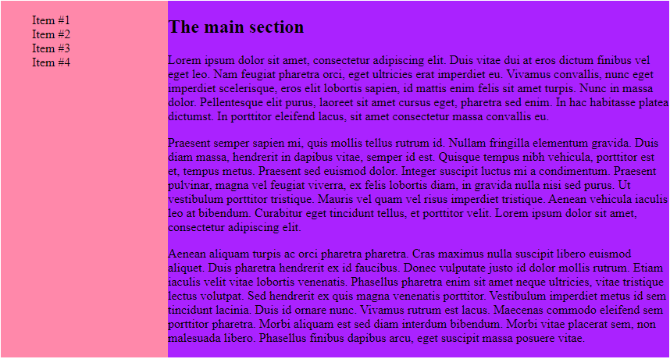
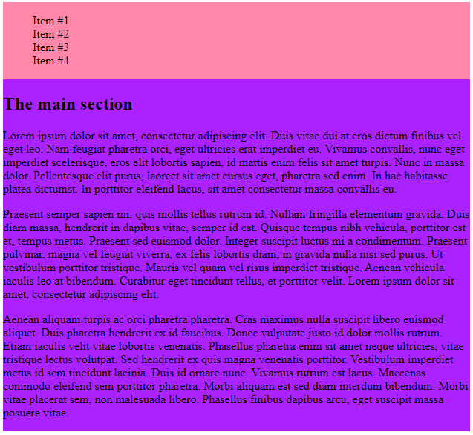
Responsive design. Media query example
<style>
body { display: flex; }
#left {width: 25%; background-color: #ff88aa}
#main {width: 75%; background-color: #aa22ff}
@media screen and (max-width: 800px) {
body { display: flex;
flex-direction: column; }
#left, #main { width: 100%; }
}
</style>
<body>
<section id=“left”> …. </section>
<section id=“main”> …. </section>
</body>

Slide 32
CSS neat typography: web fonts
see Google web fonts: https://fonts.google.com/
usage example:
<link rel="stylesheet" type="text/css"
href="https://fonts.googleapis.com/css?family=Jura">
<style>
body {
color: #cfd2da;
font-family: 'Jura', sans-serif;
font-size: 0.9rem;
}
</style>

Slide 33

Neat CSS icons: google icons
<link rel="stylesheet" href="https://fonts.googleapis.com/icon?family=Material+Icons">
<i class="material-icons" style="font-size:48px;color:red“>folder</i>
<i class="material-icons" style="font-size:48px;color:red“> cloud_upload</i>

Slide 34

Neat CSS icons: fontawesome
<link rel="stylesheet" href="https://cdnjs.cloudflare.com/ajax/libs/font-awesome/4.7.0/css/font-awesome.min.css">
<i class="fa fa-car" style="font-size:60px;color:red;"></i>

Slide 35
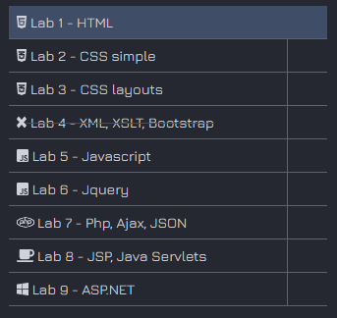
More fontawsome ..
<script defer src="https://use.fontawesome.com/releases/v5.0.8/js/all.js"></script>
<li><div>
<a href="#" id="1">
<i class="fab fa-html5"></i>
Lab 1 – HTML
</a>
</div></li>
<li><div>
<a href="#" id="2">
<i class="fab fa-css3-alt"></i>
Lab 2 - CSS simple
</a>
</div></li>
...

